Slide 1
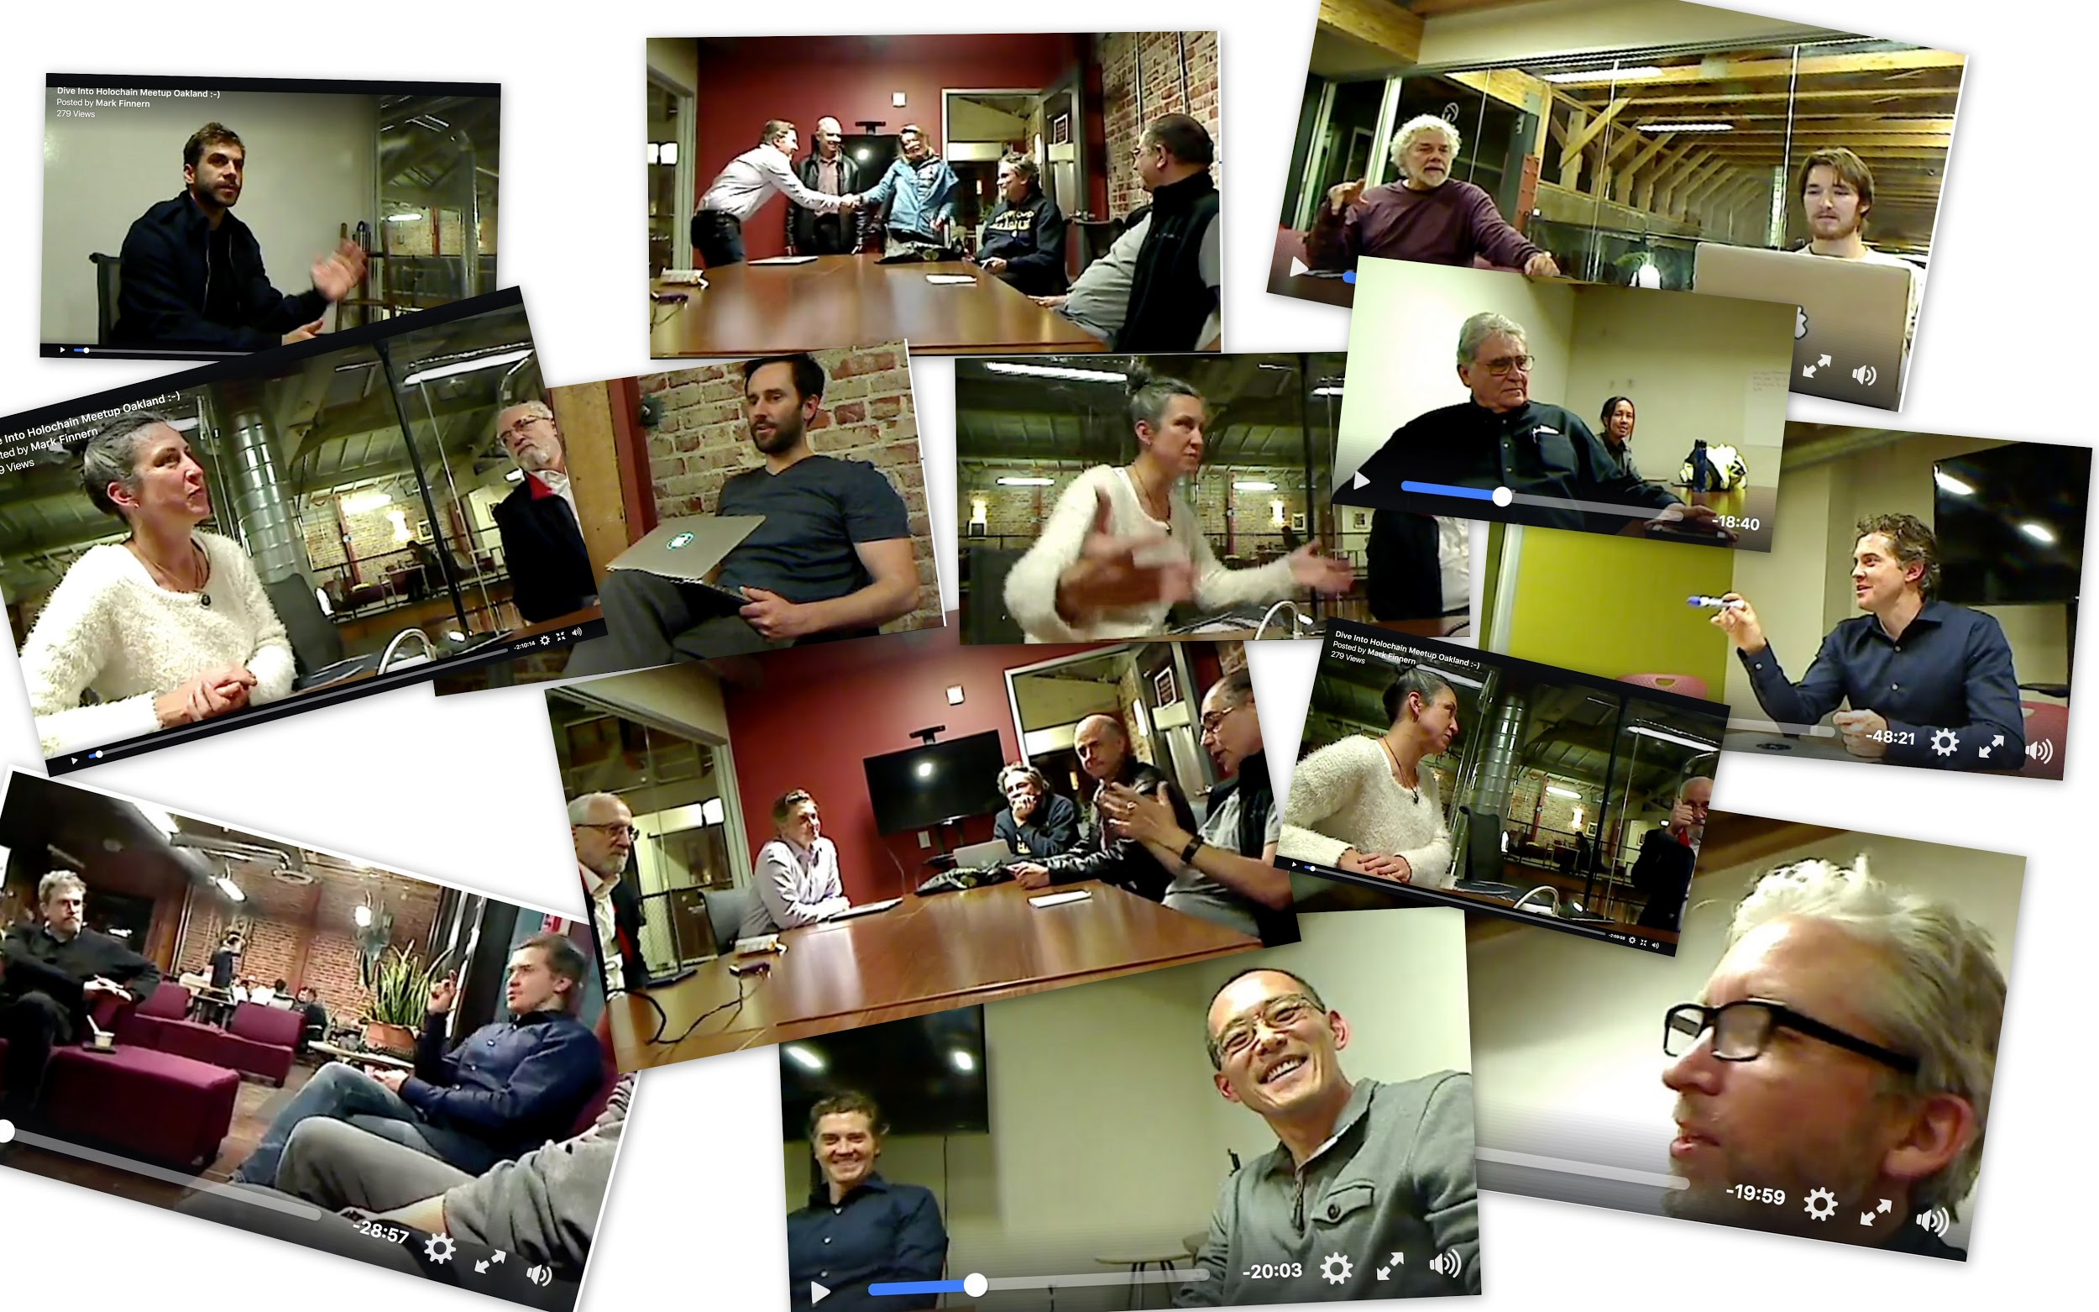
Bay Area Dive into Holochain Meetup

Slide 2
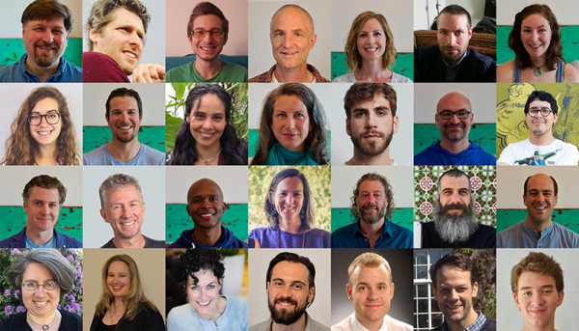
Holochain Community We are a community of passionate humans building a distributed cloud, owned and run by users like you and me.

Slide 3
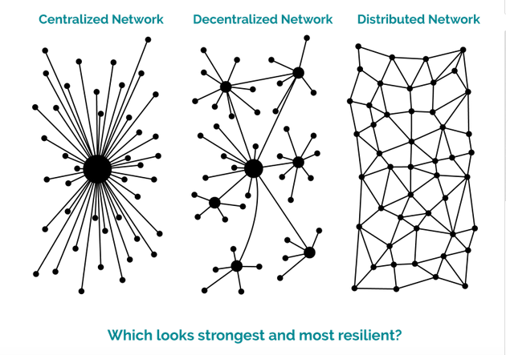
Issues with Centralized Systems I/II

Slide 4
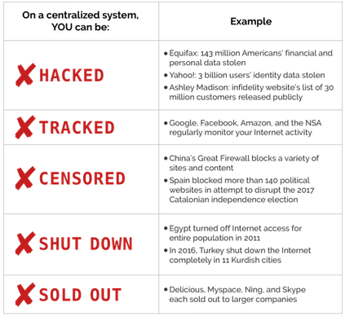
Issues with Centralized Systems II/II

Slide 5
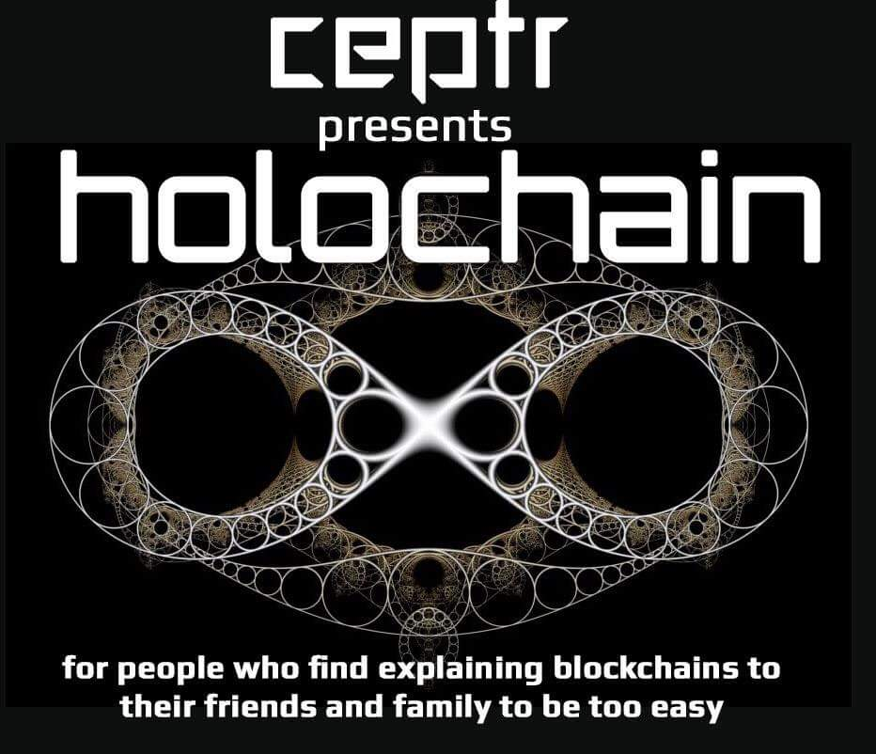
Notes:
Blockchain: Data-centric, a single global data set - one shared reality across all nodes.
Holochain: Agent-centric, allows nodes to act independently, or in tight coordination only with counterparties, and then share independently evolving data realities that come to agreement over time.

Slide 6

Blockchain is about managing a consensus about what was “said.”
Holochain is about distributing a consensus about how to “speak” [Art Brock]

Slide 7

Examples in Nature I/II: Language
We are a speaker of a language when we know how to use the rules of that language properly
We don’t have to know all the same words (because we can use the rules to explain unknown ones)
We don’t need to have the same experiences
We certainly don’t need some global ledger of everything that’s ever been said, or require consensus about what has been said
Yet there are infinite possibilities for how we may communicate with one another within the boundaries of this language.
Notes:
Photo by Janko Ferlič on Unsplash

Slide 8

Examples in Nature
Examples in Nature II/II:
Cells
Each cell carries a copy of their rules or instruction set (i.e. DNA)
There is no global ledger about the state of trillions of cells
Yet, our cells coordinate in a highly decentralized manner, without the latency or bottlenecks of central control

Slide 9
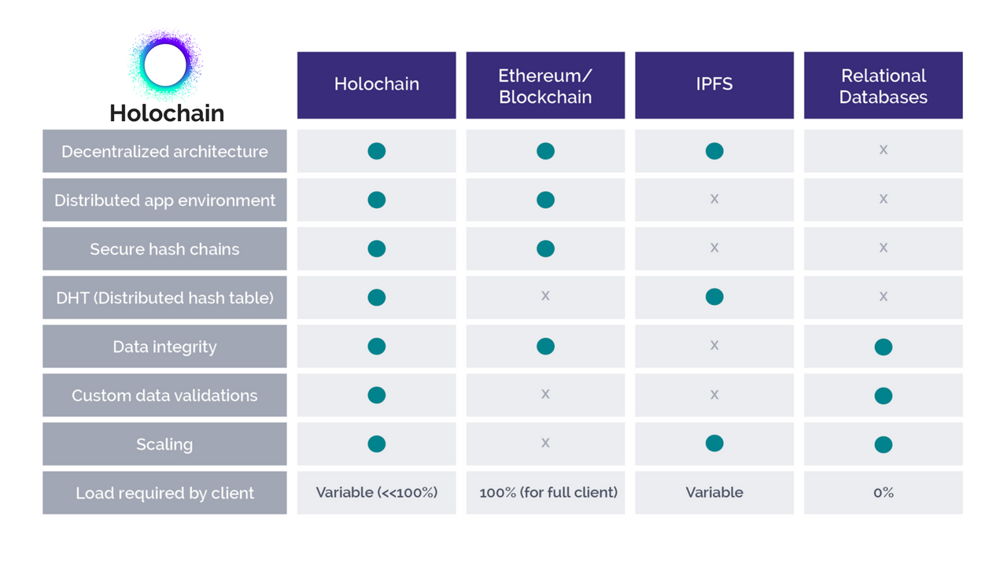
Holochain vs Blockchain
Notes:
Blockchain: Data-centric, a single global data set - one shared reality across all nodes.
Holochain: Agent-centric, allows nodes to act independently, or in tight coordination only with counterparties, and then share independently evolving data realities that come to agreement over time.

Slide 10
Holochain vs Blockchain
 | Current System | Blockchain | Holochain
Security/Trust | Database held “securely” by third party | Distributed Global Ledger of “Indisputable Truth” | Community-set shared rules to play by + social accountability through validation
Governance | Oligarchy | “Consensus” & Smart Contracts | Pluralistic commons
Model | Dominance | Liberty | Holographic Coherance (Biomimicry)
Ontology | Corporation-centric | Token-centric | Agent-centric
Example (Jamie Klinger) | A centralized app like Snapchat offers you a small file (the app) to download that sends data through centralized servers. | A decentralized app like TenX runs on a decentralized blockchain (Ethereum). | A distributed app run locally on your personal device and coordinates through peer-to-peer connections.

Slide 11
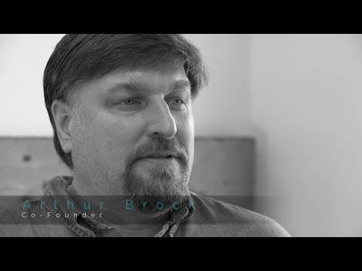
Holochain vs Blockchain

Slide 12
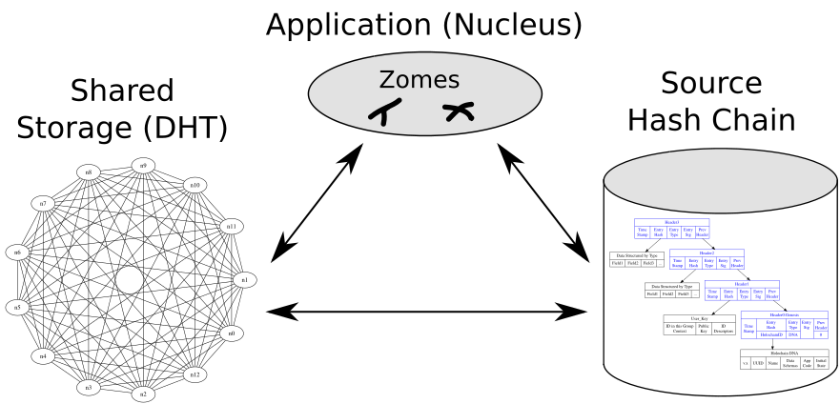
Overview of Holochain Architecture

Slide 13

Overview of Holochain Architecture
What are Distributed Hash Tables [D.H.Ts] ?

Slide 14
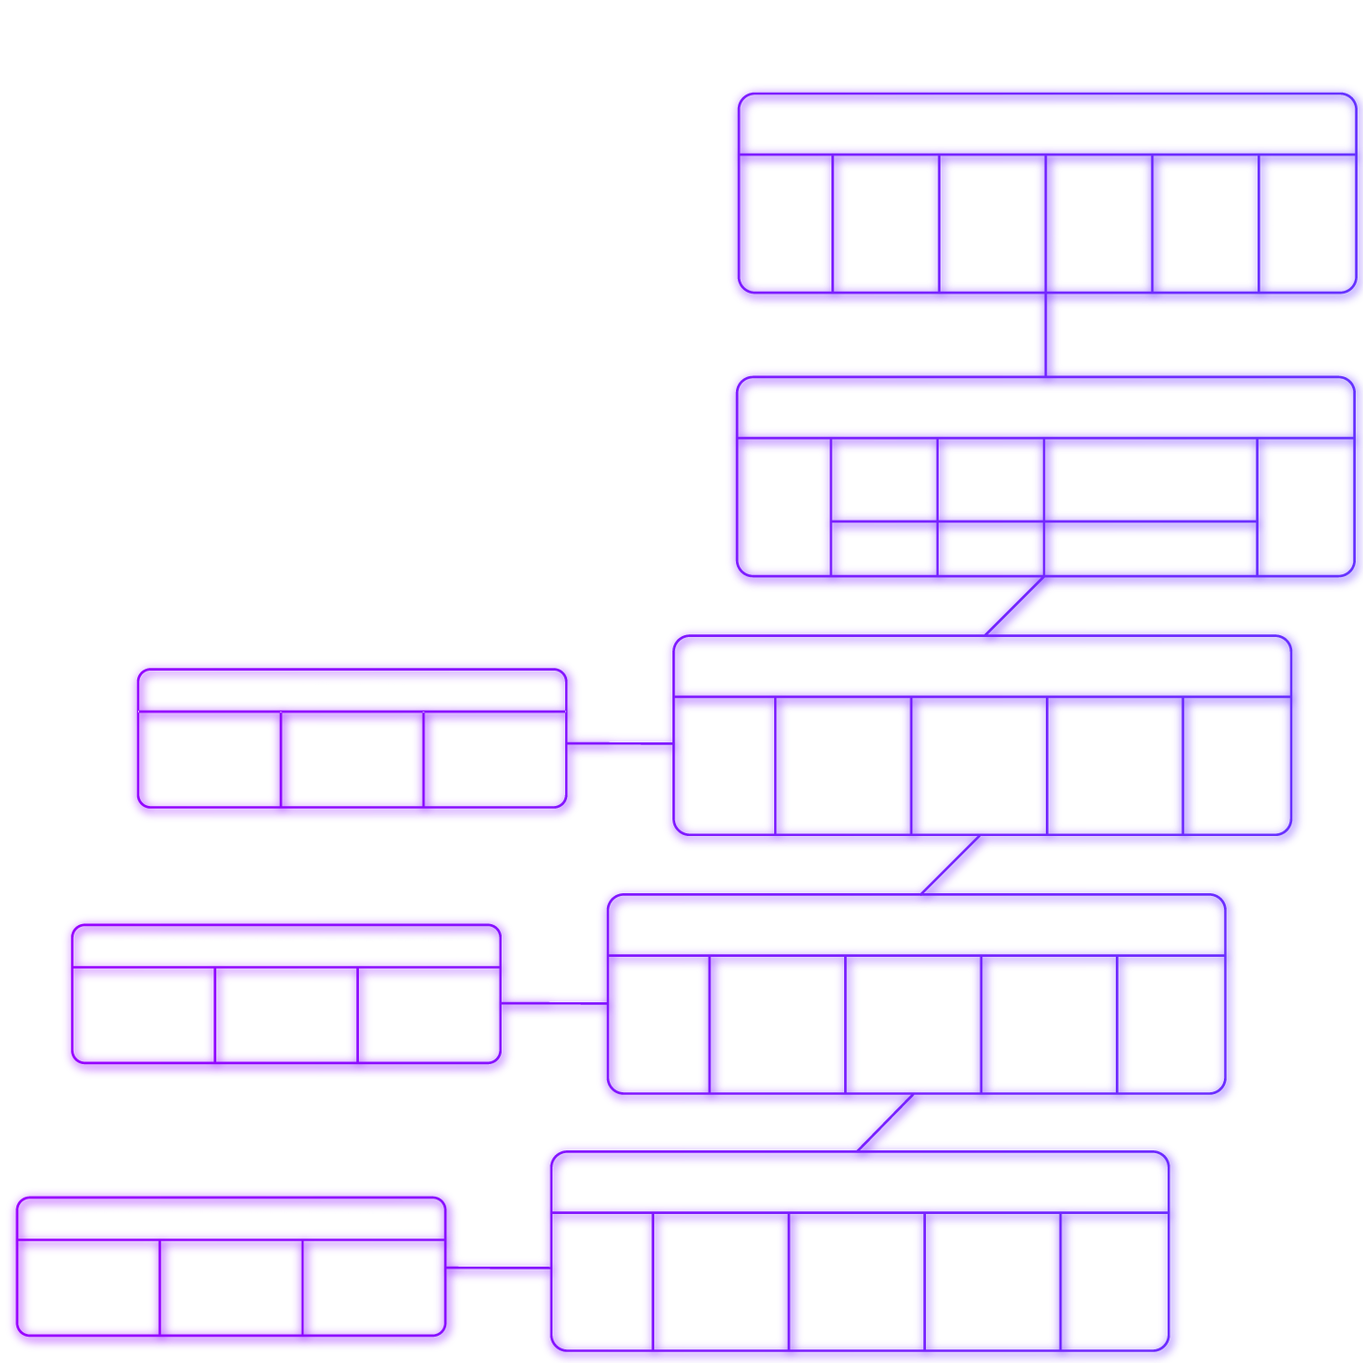
Overview of Holochain Architecture I/II
Notes:
Distributed Hash Tables (DHTs) are already used for file sharing (bittorrent) and other widespread applications. In these systems, the data is content addressable by cryptographic hash, so you can confirm you receive unaltered data by hashing it yourself. In our validating DHT, we confirm the provenance of every piece of data, validating the signature of its author, and that it has been committed to their local chain. Multi-party transactions create a “crossing” of chains which also assure that even if you try to alter your own chain, your transaction is published by others. Our DHT also has an unusual feature which allows meta-data to be put on data in the DHT which can be used to publish information about a person/node (such as their transactions, or top of their hashchain) or data element (such as tags, comments, or ratings). Just like validation rules on blockchain nodes, if someone hacked their code to behave differently, even if they colluded with others, the rest of the nodes on the DHT would not validate their altered behavior and they will have essentially just forked themselves out of being able to participate on that holochain.

Slide 15
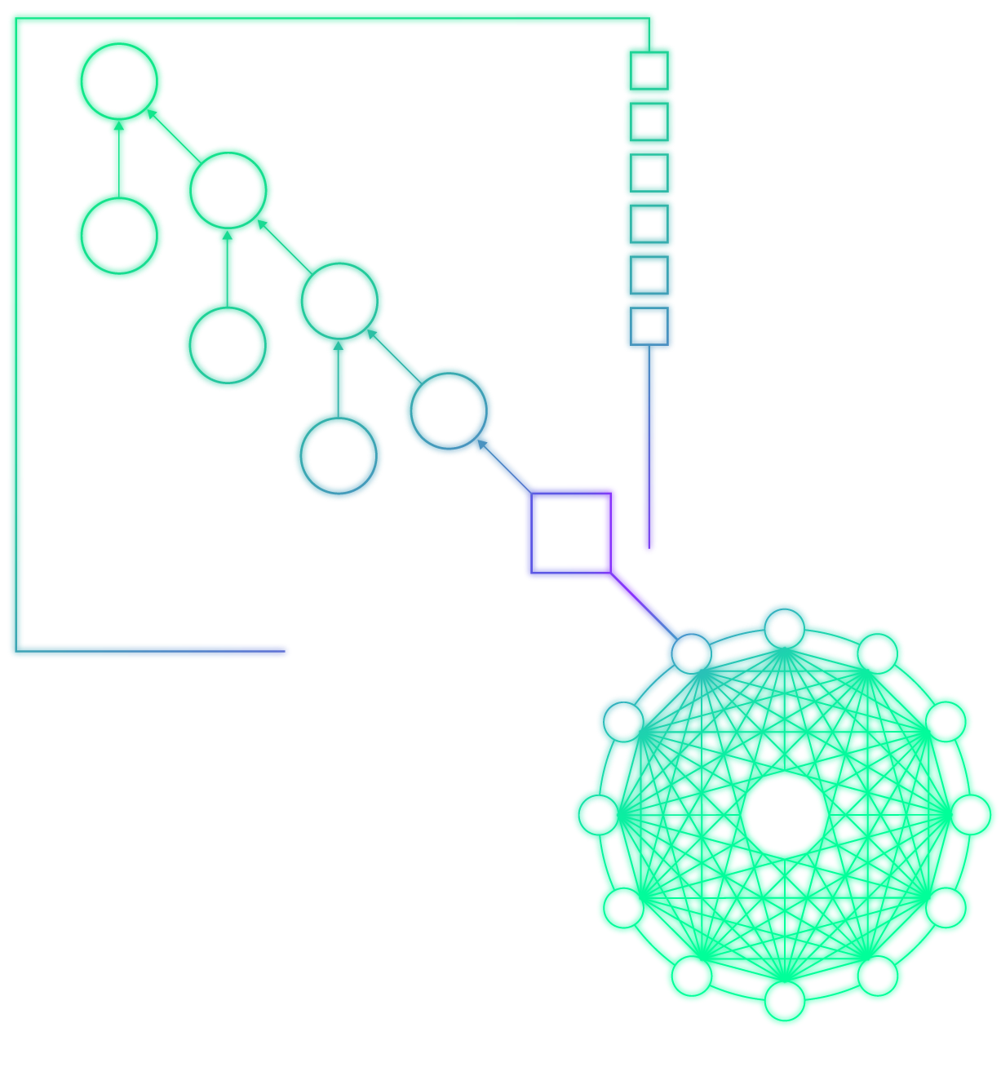
Overview of Holochain Architecture II/II
Notes:
Distributed Hash Tables (DHTs) are already used for file sharing (bittorrent) and other widespread applications. In these systems, the data is content addressable by cryptographic hash, so you can confirm you receive unaltered data by hashing it yourself. In our validating DHT, we confirm the provenance of every piece of data, validating the signature of its author, and that it has been committed to their local chain. Multi-party transactions create a “crossing” of chains which also assure that even if you try to alter your own chain, your transaction is published by others. Our DHT also has an unusual feature which allows meta-data to be put on data in the DHT which can be used to publish information about a person/node (such as their transactions, or top of their hashchain) or data element (such as tags, comments, or ratings). Just like validation rules on blockchain nodes, if someone hacked their code to behave differently, even if they colluded with others, the rest of the nodes on the DHT would not validate their altered behavior and they will have essentially just forked themselves out of being able to participate on that holochain.

Slide 16
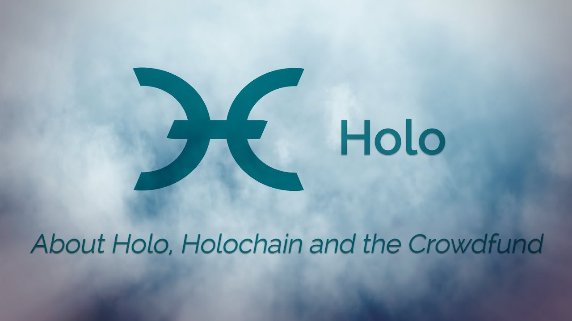
Holochain and Holo
Holochain = Distributed Architecture
Holo
Application on Holochain
Enables accessibility to a Beginning User
First Launch of a Full Scale Application
First Launch of a Token-less, Mutual Credit Currency backed by a real asset (computing power)

Slide 17
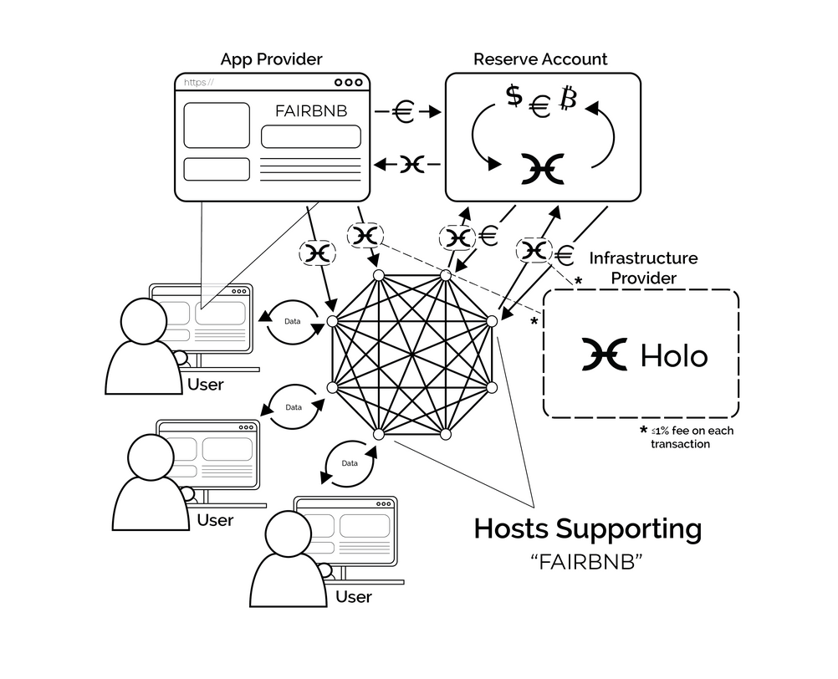
Overview of Holo Ecosystem

Slide 18

What Are Holochain Applications Best Suited For?
Governance, Collaboration, and Organizational Tools
Social Networks and Social Media
Platform Cooperatives
Directly p2p sharing economy apps
Community Resource Management (the Commons)
Tokenless, mutual-credit cryptocurrencies and reputation systems
Individual controlled data collection (e.g. in the Health sphere)
Supply Chain & Open Value Networks

Slide 19
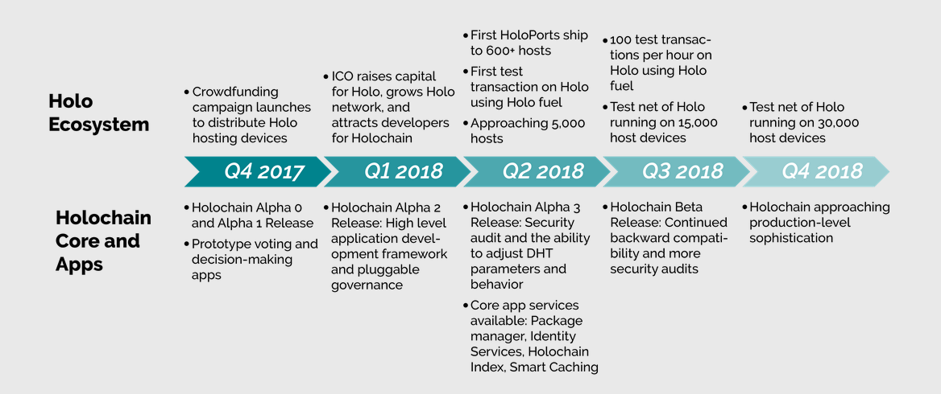
Timeline

Slide 20
Where do we go from here?
Notes:
Let’s talk about it. What do you think?
How do we want to organize future meetups?
How can we co-learn?
What are you excited about?
How do you want to be involved?

Slide 21
Connect with Community
Holochain Public Mattermost Chat https://chat.holochain.net
Holochain https://holochain.org/
Holo https://holo.host/
Resources
Developers https://developer.holochain.org/
Github Alpha release of holochain: bit.ly/githolochain
Currency (Current-See) Geeks https://medium.com/@artbrock
Notes:
Let’s talk about it. What do you think?
How do we want to organize future meetups?
How can we co-learn?
What are you excited about?
How do you want to be involved?

